Slide 1
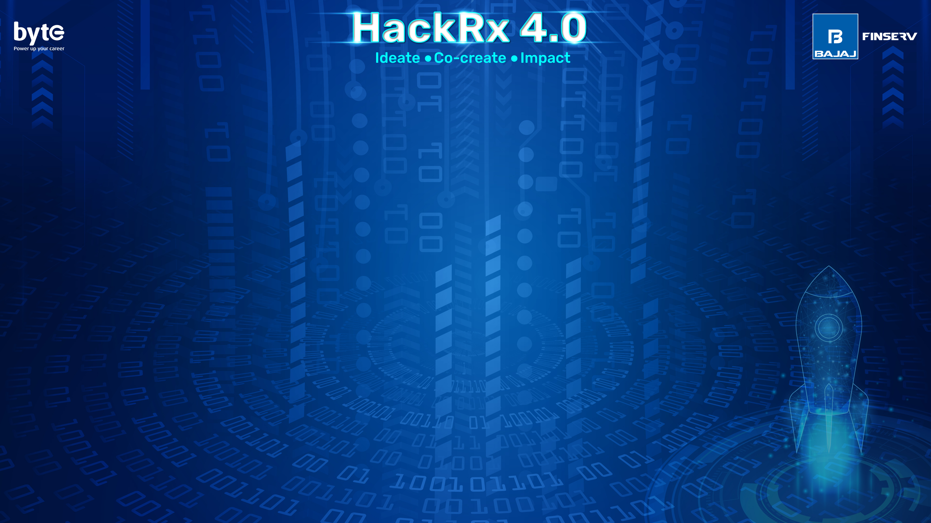
Team name-689286-U06Y2L3A
Team members:
Rupa polisetti |2025|Shri Vishnu Engineering college For women
Chetana sri Voleti|2025|Shri Vishnu Engineering college For women

Slide 2
About us:
We participated in GDSC hackathon 2023 which was about 24 hrs and we developed a web application named Job Jaggat as a solution for the 8th SDG goal i.e economic growth and providing decent employment which is a job searching platform for economically backward people . We have provided a facility to search for jobs at their locality and made our website understandable to artisans and rural people by using goggle API’s,TechStack:HTML,CSS,Bootstarp,Js,jsp,mysql,java,AI,ml
Projects-we have done a Python project -triangular vertices which is about to predict the given geometric shapes based on set of points in triangular grid,the predictable shape can be triangle,parallelogram and hexagon
We have done another python project –password suspects on knowing the possible password that could be generated from the given input
We have developed web applications–
Event scheduler –which diligently sends timely reminders to users, ensuring they never miss an important task or deadline again, not only sends reminders to users but also efficiently organizes and improves their task management process, leading to enhanced productivity and better outcomes.TechStack:HTML,CSS,Bootstarp,Js,jsp,mysql,java
Exam seat arrangement system- in this the faculty ,students have facility to organize their academic schedules and students can can know their seating plan a before head without panicking right before the exam. TechStack:HTML,CSS,Bootstarp,Js,jsp,mysql,java
Earned 8 badges on google cloud career practitioner pathway campaign by completing google cloud foundations course

Slide 3
problem statement-IX:Forgery Detection
Overview of the solution:
we have many existing techniques individually for analysing forgery of document to some extent which has many inconsistencies and artifacts that may arise due to tampering .some of the minute details can be overlooked .Using single technique for forgery detection may end up giving us incorrect results where we can’t determine whether the document is proper or not.So,it is not proper to use single technique for analysing a document to full extent and know the forgery percentage exactly.
So, we came up with an idea to combine all the multiple techniques into the same software application which can perform all the possible techniques step by step to identify the forgery document which gives high accuracy results with minimalistic errors

Slide 4
Tech Stack
Programming languages:python,java
Machine learning frameworks:Tensor Flow,scikit-learn
Computer vision Libraries:OpenCV
Deeplearning libraries:Keras(TensorFlow(,Py Torc
Datastorage and Processing:MySQl
Cloud Services:Amazon web services,Microsoft Azure
Version Contorl:GIT
Development Environment:Integrated Development Environments (IDEs) like PyCharm, Jupyter Notebook, or Visual Studio Code
Deployment:Flask And Django

Slide 5
Detailed Description of the solution
Our idea is to combine all the multiple techniques into the same software application which can perform all the possible techniques step by step to identify the forgery document which gives high accuracy
User Interface: this user interface allows users to interact with the forgery detection application. This could be a web-based interface or a desktop application, depending on your requirements.
Document Input: this module provides a mechanism for users to input the document that needs to be analyzed for forgery. This could be done through file upload, scanning, or integration with document management systems.
Preprocessing Module:this module performs necessary operations on the input document to prepare it for analysis. This involves image resizing, noise reduction,text extraction.
Technique Modules:this module has individual modules for each forgery detection technique you want to incorporate.It has modules for metadata analysis, statistical analysis, OCR-based text comparison, image forensics, and so on.
Ensemble Module:this module ensembles module that combines the outputs of all the individual technique modules.Decision Module: this module gives results from the ensemble module and provides a final determination on the authenticity of the document. This uses decision rules, thresholds, or machine learning algorithms for evaluating result.
Reporting and Visualization:this module visualises the results . This include detailed reports highlighting the findings of each technique and the overall forgery assessment.
Scalability and Performance:for processing large number of documents concurrently.the system must handle parallel processing, utilize distributed computing, or leverage cloud resources to ensure efficient and timely analysis.

Slide 6
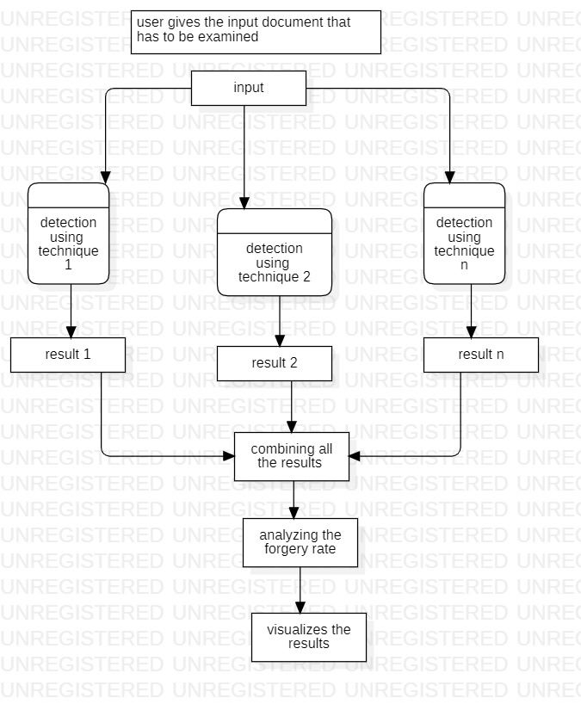
Data Flow Diagram

Slide 7
So, how is our solution different?
We came up with a unique solution that is not in existence till now. We thought of generalizing a huge procedure of forgery detection into a digital solution .Currently, there were many manual forgery detections which are not done accurately .so we have gone through all those techniques and thought of combining multiple techniques into a single software application
Our solution has multiple advantages such as
-> increases accuracy by indicating multiple forgery detection techniques
->provides comprehensive analysis
->reduces false positives and false negatives
->our solution is robust and resilient
->our solution is flexible and adaptable
->User-friendly
->The architecture of our solution is scalable
->It provides enhanced trust and transparency

Slide 8
Future possible enhancements
Customizable Configurations-we will provide options for users to customize the analysis configurations based on their specific needs like adjusting the sensitivity of certain techniques, selecting subsets of analysis steps for improved accuracy and efficiency.
Interactive Visualization-to display the results of each analysis step. This can include visual representations of signature characteristics, document comparisons, ink and paper analysis results, and machine learning outputs. Interactive visualization can aid users in understanding and interpreting the forgery detection findings effectively.
Advanced Machine Learning-we continuously improve the machine learning component by incorporating more sophisticated algorithms and deep learning techniques,training the models on larger and more diverse datasets, will enhance the accuracy and generalizability of the forgery detection system.
Collaboration and Integration-integrating with forensic document examination databases, document management systems, or collaborating with experts in the field to exchange knowledge and improve the overall capabilities of the forgery detection solution.
Continuous Improvement and Updates-regularly update the software application to incorporate advancements in forgery detection techniques, emerging forgery methods, and new research findings,it ensures that the system remains up-to-date and effective in identifying evolving forgery attempts.

Slide 9
Risks/ Challenges / Dependencies
We faced a challenge regarding the Insufficient training data which impact the model's performance. and does not include a wide range of forgery types, the model may struggle to generalize to new and unseen cases.
Coming to the performance of forgery detection application .It is impacted when dealing with large volumes of documents or concurrent users. Ensuring scalability, optimizing computational resources, and addressing potential bottlenecks are critical to maintaining the model's efficiency and responsiveness.

Slide 10
Acceptance Criteria:
Accuracy: In our Solution we provided high level of accuracy by examining even the minimum elements of our project.
Comprehensive Coverage: Our solution can detect any type of forgery documents.
Scalability: our solution can handle large volumes of claims and adapt to new types of forgery techniques as they emerge.

Slide 11
Anything Else ?
We found our solution to be very useful to the society and this can stop fraudulent means of. documents and enhances safety to the intellectual property and provides justice to who are eligible for it.

